Slide 1
Building Stakeholder Confidence Through an Automated Testing Solution
SOFTWARE QUALITY CONFERENCE
PACIFIC NW
Rebecca Long, STCU October 2016
Notes:
Focus for this talk is on the people side of the software world
How people and their emotions play into software and the perception of software quality is extremely important
I’m going to talk through the story of my team and how we lost the confidence of our stakeholders, how that impacted our software delivery, and then explain how we used an automated testing solution to solve this problem.

Slide 2

Overview
SOFTWARE QUALITY CONFERENCE
PACIFIC NW
Background on me and my organization
The growing pains my team experienced
The challenges that arose
How we are working through these growth opportunities

Slide 3
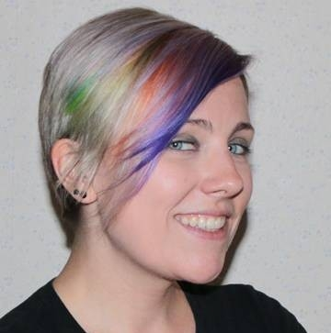
Who am I?
SOFTWARE QUALITY CONFERENCE
PACIFIC NW
I have rainbow hair
Also hold a bachelor & master degrees in computer science
10 years experience in software
Taught various computer courses at local university and community colleges
Co-lead the local Spokane QA user group SpoQuality
Spent the last 4 years at Spokane Teachers Credit Union in the role of software quality assurance engineer

Slide 4
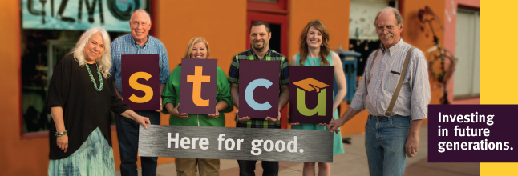
Who is STCU?
SOFTWARE QUALITY CONFERENCE
PACIFIC NW
Spokane Teacher’s Credit Union is the 3rd largest credit union in Washington state
Based out of Spokane, Washington
Internal software team grew from 5 people to 13 in the last 4 years
Demand for us to build more awesome software has only increased!

Slide 5

SOFTWARE QUALITY CONFERENCE
PACIFIC NW

Slide 6
Not that long ago…
SOFTWARE QUALITY CONFERENCE
PACIFIC NW
We had a small software team of 5 people (still large in the world of credit unions).
We mainly built scripts and helper apps for employees.
But we had grand dreams of bigger, all inclusive tools for both employees and members to use!
Out of these dreams, our main large application was born → Toolkit
For employees to use to help service our members in one convenient location
One stop shop for member service

Slide 7
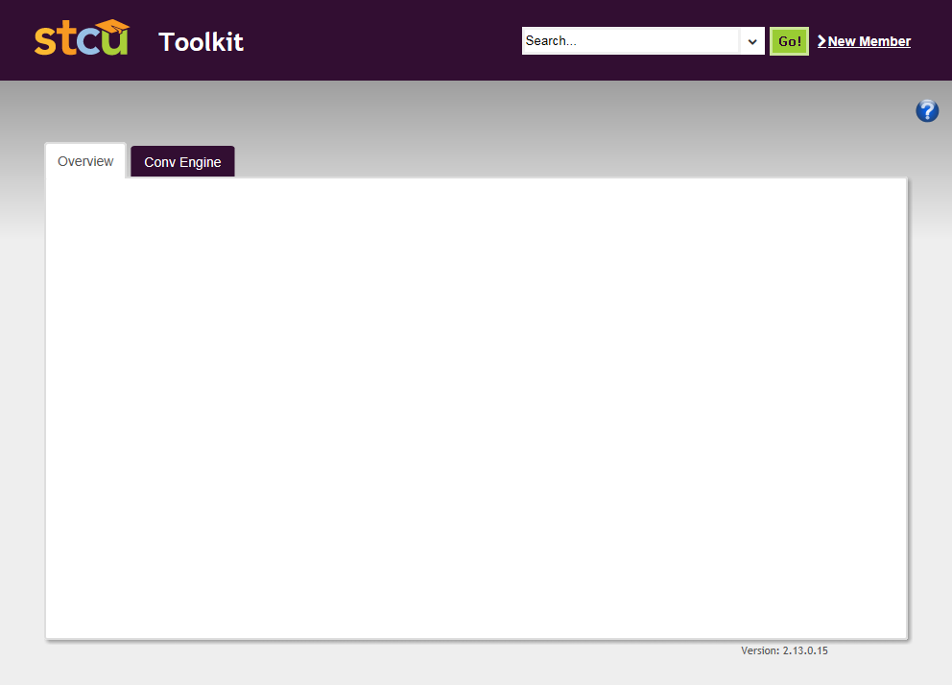
Toolkit Features
SOFTWARE QUALITY CONFERENCE
PACIFIC NW
Create new members
Look up member accounts & transactions
Look up & update member contact info
Create & maintenance accounts
Credit card balance transfers
Order checks & debit cards
Member conversation starters
Print or eSign forms prepopulated with member info
Notes:
Toolkit is used by most employees in the credit union to service members
It is the main interface for employees to use to update member data

Slide 8

SOFTWARE QUALITY CONFERENCE
PACIFIC NW
Notes:
As a small team jumping into our first big application, we had some hurdles to work through as we grew into our big dream

Slide 9
The Challenges We Faced
SOFTWARE QUALITY CONFERENCE
PACIFIC NW
Learning the Environment Setup Needs
This was our first application with such deep integration into the multitude of vendor systems we work with

Slide 10
Toolkit Environment
SOFTWARE QUALITY CONFERENCE
PACIFIC NW
Notes:
Our wonderful new application has a complicated environment setup with many dependencies on external vendor systems

Slide 11
The Challenges We Faced
SOFTWARE QUALITY CONFERENCE
PACIFIC NW
Proper Release & Feature Tracking
Our tracking processes for what items were contained in releases were under par

Slide 12
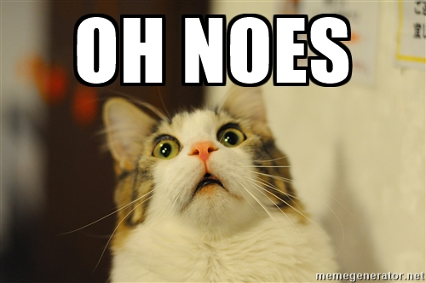
Release Tracking
SOFTWARE QUALITY CONFERENCE
PACIFIC NW
Did not originally fully utilize our issue tracking tools.
Trying to do too many things in each release.
Extra unexpected changes got included in release builds.
Forgot to include expected changes in release builds.
Stakeholders always noticed
Notes:
Did not originally fully utilize JIRA to help with the release process.
Missed items included in release only to be found in UAT by stakeholders or by users in production.
Stakeholders always noticed when we promised features or bug fixes but then those items did not make it into our release candidates for them to test.

Slide 13
The Challenges We Faced
SOFTWARE QUALITY CONFERENCE
PACIFIC NW
Using Stakeholders for Testers
Rush to get things out the door often gave stakeholders more testing responsibilities than ideal

Slide 14
Stakeholders as Testers
SOFTWARE QUALITY CONFERENCE
PACIFIC NW
Requirements
Development
QA Testing
UAT
Production
Our Stakeholders = internal back-office departments
Normal to have stakeholders assist with User Acceptance Testing (UAT)
Notes:
Toolkit’s user base is employees which are represented by a couple specific back-office departments who play the role of our stakeholders
Our stakeholders performed the User Acceptance Testing on Toolkit
Unfortunately, they regularly would be provided with release candidates of the software that were not fully vetted by the internal QA
Due to lack of time and rush to get features out the door quickly
Led to stakeholders discovering lots of new bugs
Stakeholders were leaned upon for a lot of the needed regression testing

Slide 15
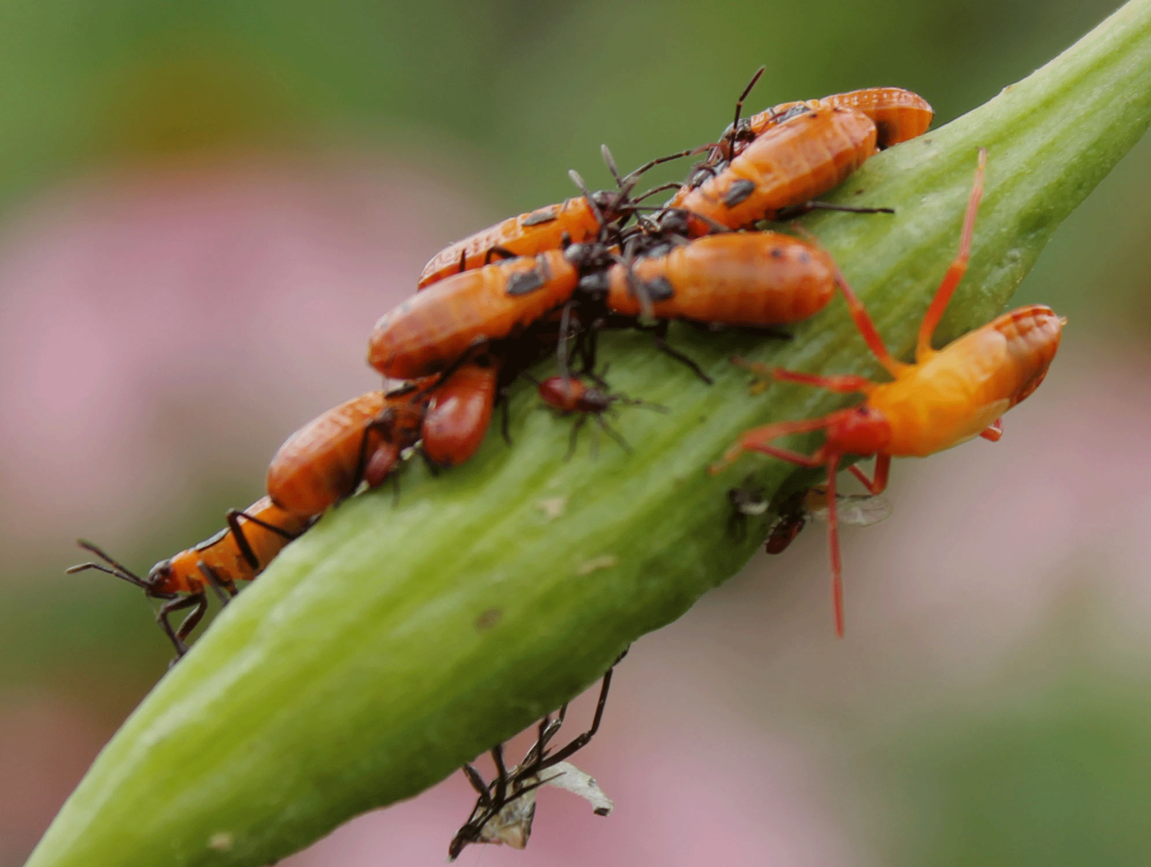
Stakeholders as Bug Testers
SOFTWARE QUALITY CONFERENCE
PACIFIC NW
Rush to get features out the door quickly.
Insufficient time for full internal testing.
Stakeholders leaned upon for bug testing.
=
Stakeholders discovering lots of new bugs
Notes:
Unfortunately, they regularly would be provided with release candidates of the software that were not fully vetted by the internal QA
Due to lack of time and rush to get features out the door quickly
Led to stakeholders discovering lots of new bugs
Stakeholders were leaned upon for a lot of the needed regression testing

Slide 16

Stakeholders as Bug Testers
SOFTWARE QUALITY CONFERENCE
PACIFIC NW
Netscape should have taught us long ago that this was a bad idea…
http://www.joelonsoftware.com/articles/fog0000000067.html
Notes:
Once the developers called something “done” or even halfway “done” they would release it into the wild without any testing.
Netscape did what was called “wide betas” having millions of people download their unfinished, buggy releases.

Slide 17
The Challenges We Faced
SOFTWARE QUALITY CONFERENCE
PACIFIC NW
Stakeholder Confidence
Due to our other challenges, confidence from stakeholders in our processes dwindled

Slide 18

SOFTWARE QUALITY CONFERENCE
PACIFIC NW
Notes:
It can be hard for stakeholders and users to understand growing pains of software teams
Just like with any relationship, if you promise something and regularly don’t deliver on that promise, trust starts to degrade.
Same holds true between software teams and users

Slide 19
Broken Trust
SOFTWARE QUALITY CONFERENCE
PACIFIC NW
With confidence lost in both the application and the software team’s processes, stakeholders were now…
Requesting greater detailed release notes for all release candidate builds
Retesting every item in the release notes in addition to performing a full regression test suite by hand
Notes:
With confidence lost in both the application and the software team’s processes, stakeholders were now…
Requesting greater detailed release notes for all release candidate build
Retesting every item in the release notes in addition to performing a full regression test suite by hand
A lot of duplicate effort ended up being performed
Which slowed down the release cycle (opposite of the desired quick agile turn-around on releases)
Furthered tension between departments

Slide 20

SOFTWARE QUALITY CONFERENCE
PACIFIC NW

Slide 21
Let’s Rebuild
SOFTWARE QUALITY CONFERENCE
PACIFIC NW
What ingredients are needed to rebuild trust?
Trust
Reliability
Accountability
Investment
Notes:
What elements are needed to rebuild trust?
Accountability → first you need to acknowledge what mistakes were made, own up to the reality you are in
We are all human, users will respect that acknowledgement and you being up front with wanting to fix the situation.
Reliability → Need to build a system that both your team and the users can rely on.
Investment → Obviously you and your software team need to be invested in fixing the problem.
You also want to bring in the users to get their buy-in to the solution.
User investment is the key ingredient to rebuilding this trusting relationship.

Slide 22
Goals
SOFTWARE QUALITY CONFERENCE
PACIFIC NW
Automate
Consistent Tests
Stakeholders Help Write Tests
Notes:
Goals:
Automate our tests! (duh)
Bring greater consistency to our testing process (duh)
Pull in stakeholders to assist in test writing
Why is this step important? Stakeholders will feel their voice is being heard on what is important to them. Additionally they are the business experts and can genuinely help improve the quality of your test coverage.

Slide 23
Test System Design
SOFTWARE QUALITY CONFERENCE
PACIFIC NW
Stakeholder
SpecFlow Tests
Selenium
Base Application Class
Page Object | Page Object | Page Object | Page Object
Test Data Library
Core Database
Notes:
This was our automated test system solution

Slide 24

The Key to Stakeholder Involvement
SOFTWARE QUALITY CONFERENCE
PACIFIC NW
“bridging the communication gap between domain experts and developers by binding business readable behavior specifications to the underlying implementation”
http://www.specflow.org/getting-started/

Slide 25
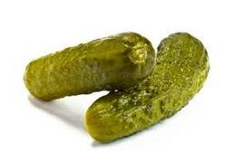
Gherkin
SOFTWARE QUALITY CONFERENCE
PACIFIC NW
“… a Business Readable, Domain Specific Language that lets you describe software's behaviour without detailing how that behaviour is implemented. Gherkin serves two purposes — documentation and automated tests.”
https://github.com/cucumber/cucumber/wiki/Gherkin

Slide 26
Gherkin
SOFTWARE QUALITY CONFERENCE
PACIFIC NW
Uses the Given-When-Then format:
Given some precondition
When some action by the actor
Then some testable outcome is achieved

Slide 27
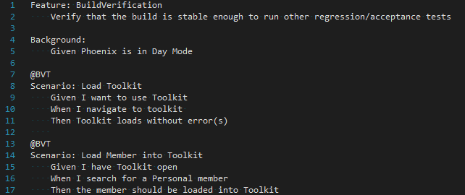
SpecFlow Tests
SOFTWARE QUALITY CONFERENCE
PACIFIC NW

Slide 28
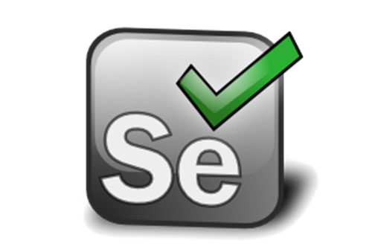
Selenium Web Automation
SOFTWARE QUALITY CONFERENCE
PACIFIC NW
Browser Automation!
http://www.seleniumhq.org/

Slide 29
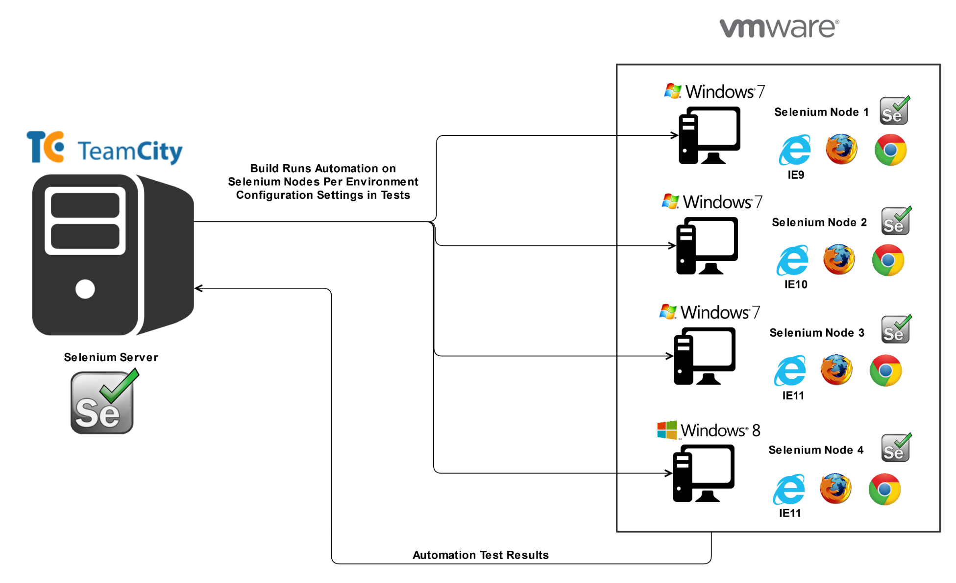
Selenium + Build System
SOFTWARE QUALITY CONFERENCE
PACIFIC NW

Slide 30
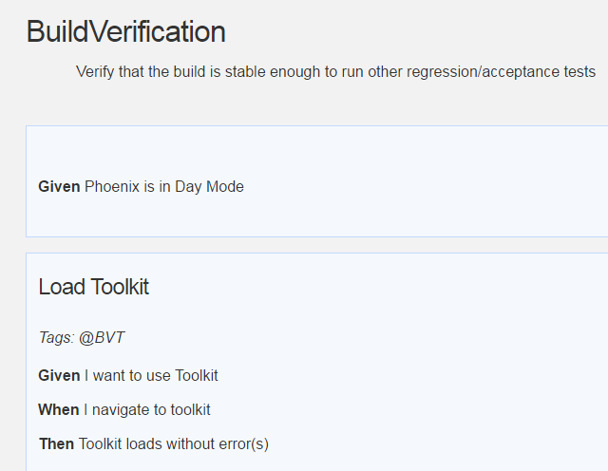
Stakeholder Friendly Reporting
SOFTWARE QUALITY CONFERENCE
PACIFIC NW
The build system produces a Pickles report after running the SpecFlow / Selenium tests
“living documentation generator”
http://www.picklesdoc.com

Slide 31

SOFTWARE QUALITY CONFERENCE
PACIFIC NW

Slide 32

Has This Really Helped?
SOFTWARE QUALITY CONFERENCE
PACIFIC NW
YES!
While we are still in the early stages of this project we are already seeing positive benefits between stakeholders and the software team
Stakeholders have an increased understanding and appreciation for the application
Stakeholders are gaining investment into our test suite
Stakeholders have a greater voice into test coverage and priority
Notes:
YES!
While we are still in the early stages of this project we are already seeing positive benefits between stakeholders and the software team
Stakeholders have an increased understanding and appreciation for the application’s infrastructure and environment setup
Stakeholders are gaining investment into our test suite giving them a greater voice into test coverage and priority

Slide 33
You Can Do This Too!
SOFTWARE QUALITY CONFERENCE
PACIFIC NW
Building an excellent partnership with your stakeholders and including them in the development of an automated test suite can boost their confidence in your test coverage and the quality of your tests.
Notes:
Bridge the gap between your software team and the end users or business owners
Building this partnership will make users happier and more confident in your product as well as increase the overall quality of what you build
You will be creating a respect spawned from mutual understanding of each others needs

Slide 34

Thank You!
SOFTWARE QUALITY CONFERENCE
PACIFIC NW

Slide 35
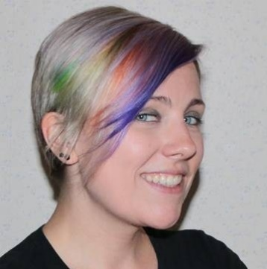


Contact Info
SOFTWARE QUALITY CONFERENCE
PACIFIC NW
Rebecca Long
rebeccal@stcu.org
LinkedIn: @amaya30
Twitter: @amaya30
Instagram: @amaya30
SpoQuality User Group
Facebook: @spoquality
Twitter: @spoquality
Spokane Teacher’s Credit Union
https://www.stcu.org

